Slide 1
PREDICTIVE ANALYSIS ON MEDICINES & DOCTORS AVAILABILITY IN GOVERNMENT HOSPITALS
PIP2001 Capstone Project
Review-0
Batch Number:
Under the Supervision of,
Ms. Shweta Singh
Assistant Professor
School of Computer Science and Engineering
Presidency University
Roll Number | Student Name
20211CSE0363 | MADHU KUMAR V
20211CSE0374 | RAVI SHIVAJI MAHIPATI
20211CSE0385 | TARUN GS
Name of the Program: CSE
Name of the HoD: Dr. Blessed Prince P/Dr. Robin Rohit/Dr.Asif Mohammed H.B
Name of the Program Project Coordinator: Mr. Amarnath J.L & Dr. Jayanthi. K.
Name of the School Project Coordinators: Dr. Sampath A K / Dr. Abdul Khadar A / Mr. Md Ziaur Rahman

Slide 2
Content
Problem Statement
Github Link
Analysis of Problem Statement
Timeline of the Project
References

Slide 3
Problem Statement Number: PSCS151
Organization: CSE
Category (Hardware / Software / Both) :Software
Problem Description:
Government hospitals provides medicines for the treatment to the patients based on the diagnosis. During the peak time of a disease, some medicines are not available in the hospital. Based on patients historical and current data, system can generate a report on what all medicines should be available in the hospital and in what quantity at particular time and location of the hospital. Doctors and specialists availability needs to be managed as per the inflow of patients. Many times patients do not find the required doctor during the peak of a disease or shortage of doctors in a hospital. Based on patient inflow for a particular ailment or disease, historical data and current data, system could generate the requirement of number of doctors required in a hospital on daily basis and also during a peak of a disease. Many times, doctors are not available when patients needs them more, e.g. on weekends, holidays, evenings etc.
• Target customer – Indian Government healthcare department
• Use Analytics to bring in efficiency in Operational functioning
• Specific use cases under purview of this program:
Difficulty Level: Simple

Slide 4
Github Link
Github Link
https://github.com/predictiveAnalysisonMedicinesDoctors

Slide 5
Analysis of Problem Statement
Government hospitals often face shortages of essential medicines and doctors during peak disease periods, leading to inefficiencies. The proposed system analyses historical and current patient data to forecast medicine demand, ensuring proper stock levels at specific times and locations. It also predicts the required number of doctors and specialists based on patient inflow patterns, addressing shortages during critical times like weekends and holidays. This solution aims to optimize resource management, targeting the Indian Government's healthcare system to improve overall operational efficiency using predictive analytics.
Technology Stack Components:
Frontend: React.js (for creating interactive web interfaces).
Backend: Python (handles server logic and processing).
Database: MongoDB (stores and manages unstructured data).
Machine Learning: Tensor Flow (predicts outcomes using data analysis).
Deployment: Docker (simplifies application deployment and scaling).

Slide 6
Analysis of Problem Statement (contd...)
Software Requirements:
Operating System: Windows, Linux, or macOS
Frontend: React.js or Angular
Backend: Python (Django/Flask) or Node.js
Database: MongoDB
Deployment: Docker or Kubernetes
Visualization: Power BI
Version Control: GitHub or GitLab

Slide 7
Analysis of Problem Statement (contd...)
Hardware Requirements:
External Hard Drives: Backup
Basic Printers: Print
Basic Scanners: Scan
Standard Desktops: PCs
Low-End Network Gear: Routers

Slide 8
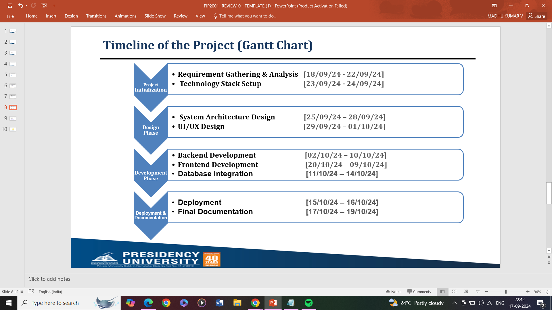
Timeline of the Project (Gantt Chart)

Slide 9
References (IEEE Paper format)
Patel, S. (2024). Managing healthcare resources effectively during peak times. Healthcare Management Review, 35(3), 89-101. https://journals.lww.com/healthcaremanagement/Fulltext/2024/05000/Managing_Healthcare_Resources_Effectively_During.10.aspx
Barlow, M. A., & Vassallo, S. R. (2023). Optimizing medicine inventory management using predictive analytics. IEEE Transactions on Biomedical Engineering, 70(1), 25-34. https://ieeexplore.ieee.org/document/9348765
Smith, J. (2023). Improving hospital efficiency with predictive modelling of doctor availability. International Journal of Health Information Systems and Informatics, 19(4), 45-59. https://www.igi-global.com/article/improving-hospital-efficiency/210586

Slide 10


